Slide 1
ECE 227C – Photonic Integrated Circuits
Dr. Milan Mašanović
Spring 2010

Slide 2
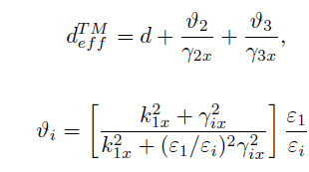
Conclusions
Propagating power proportional to magnitude of E field squared, and an effective width
  Waveguide thickness plus decay length of evanescent fields
Approximation – the effective field goes to zero at d_{eff}
Similar for TM

Slide 3

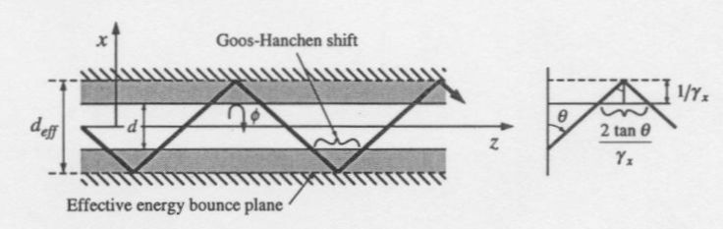

Relative power in/out waveguide
Use normalized frequency V
Energy bounces off metal plates placed at d_{eff}
Goos-Hanchen shift

Slide 4
Loss Mechanisms in Optical Waveguides
Absorption
  Free carrier
  Deep level
Scattering
  Roughness at the waveguide interface
Leakage
  Radiation losses in absence of scattering
  Higher index substrate, or bends
Classic work by Deri and Kapon (on the class site)

Slide 5
Absorption
Free carrier dominant
  Electrons below Fermi level excited to above Fermi level
  n-doped(1E18) GaAs and InP (bulk)
    22 and 4 dB/cm for
  p-doped (1E18) GaAs and InP (bulk)
    Added complexity in valence band, higher losses
    56 dB/cm for both GaAs and InP
Deep level absorption
  Issue in semi-insulating material
  3.5 and 1 dB/cm
Mitigate through overlap control between mode and p region

Slide 6
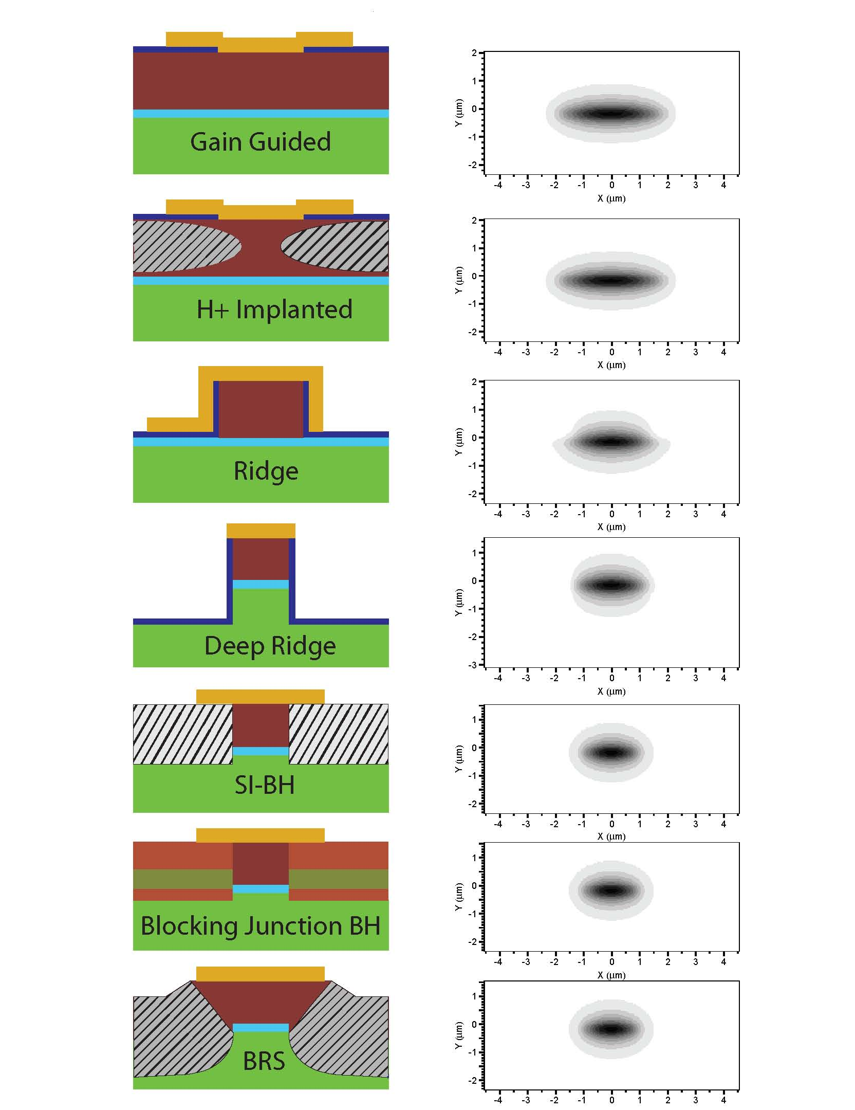
Examples – In plane confinement
Gain guided and implanted
  Apertured current
Ridge
  Current and weak photon
Deep ridge
  Strong photon, current
Buried
  All tree confinement types

Slide 7
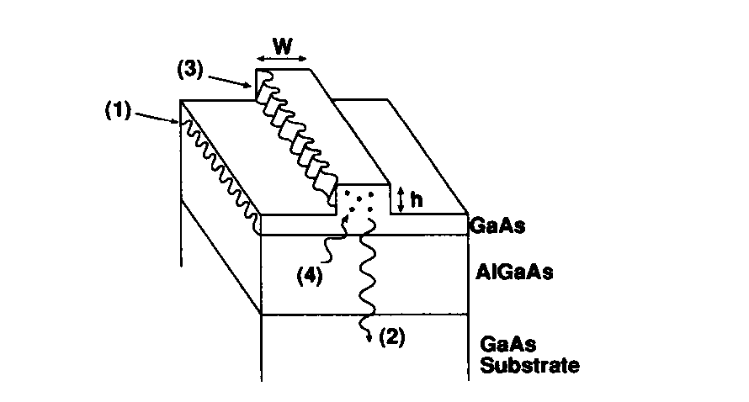
Scattering
Rough interfaces
  Epilayer boundaries, or etched interfaces

Slide 8
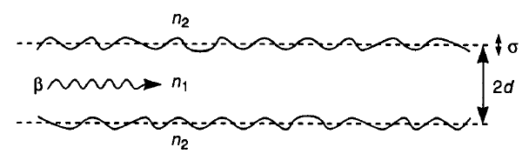
Scattering
Depends on both amplitude and spatial periodicity, as well as 2 dimensional
Theoretical treatment – using effective index theory
  Coupling into radiation modes (Marcuse)
  Using surface scattering theory
  Correlation length based methods

Slide 9
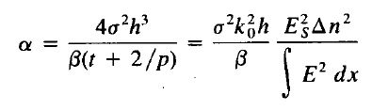
Scattering Result
σ – surface roughness; t – waveguide thickness; Δn – index difference between core and cladding;
Directly proportional to the normalized optical intensity at the guide-cladding interface

Slide 10
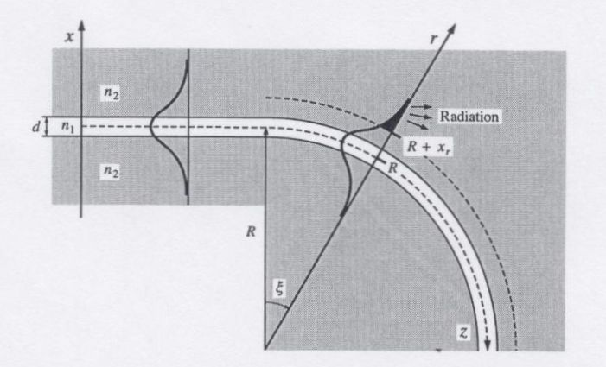
Radiation Losses
Leakage into the substrate
Bends
  At some radius, exponential tail travels faster than the speed of light -> light beyond this curvature must be radiated

Slide 11
Bends

Slide 12
General Comments
Bends are crucial for various PIC implementations
  Mach Zehnder Interferometer, Arrayed Waveguide Grating Router, Delay lines,…
Tradeoff between compactness (radius) and losses (radiation and propagation)
Difficult to analyze using numerical methods
  Off axis – BPM method not accurate; to large for FDTD…
  But, conformal mapping solves the issue

Slide 13
Example

Slide 14
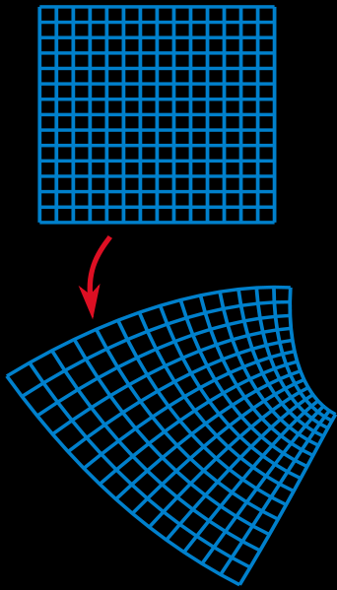
Conformal Mapping
Conformal map – map that preserves angles
Used in engineering, between different complex plane domains
  Allows for changing the geometry of the problem, which makes solution easier

Slide 15
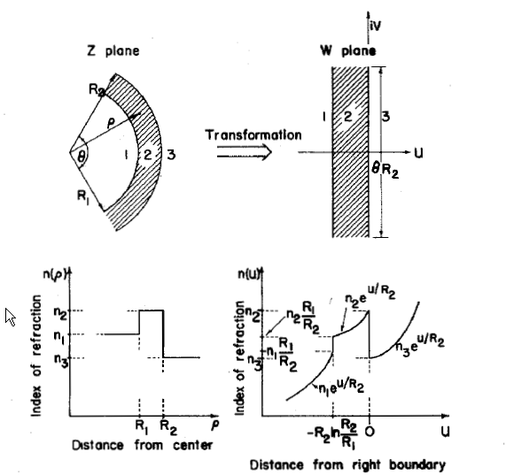
Bend cross section with conformal map
Discussion in this paper

Slide 16
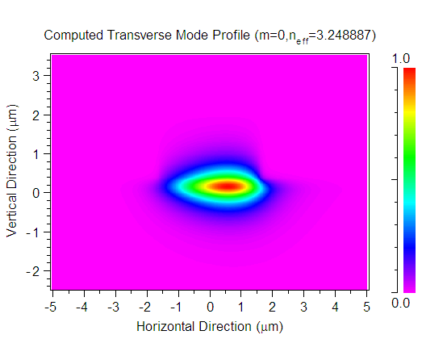
Mode Solution
Now, the modes of a bend can be solved using regular techniques (finite difference or FEM)

Slide 17
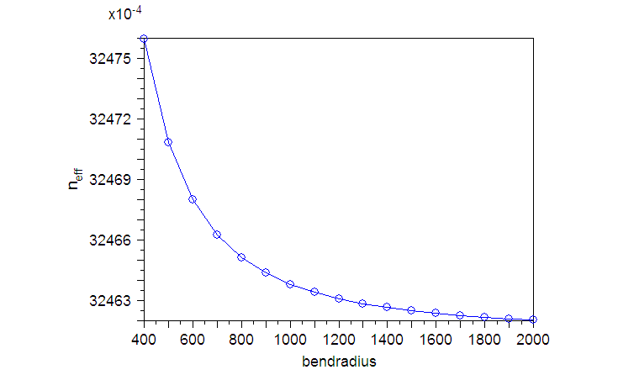
Bend Mode Calculations
00 – 400um; 16 – 2000um

Slide 18
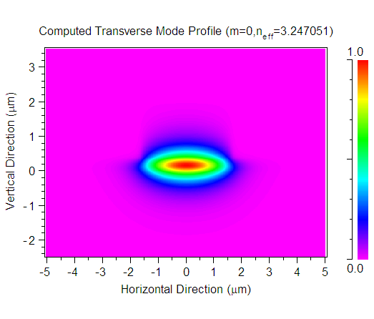
Infinite Radius Bend – Straight Waveguide
Coupling between the two – maximize overlap

Slide 19
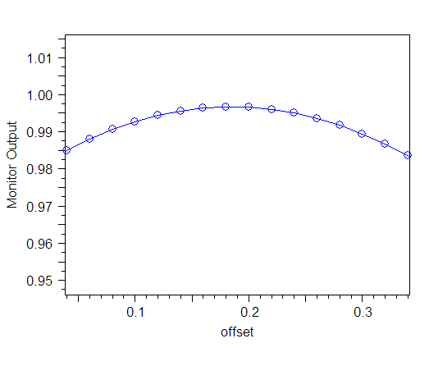
S-bends with Offsets
Interface straight and bend waveguide to maximize coupling – need to scan overlap integral

Slide 20
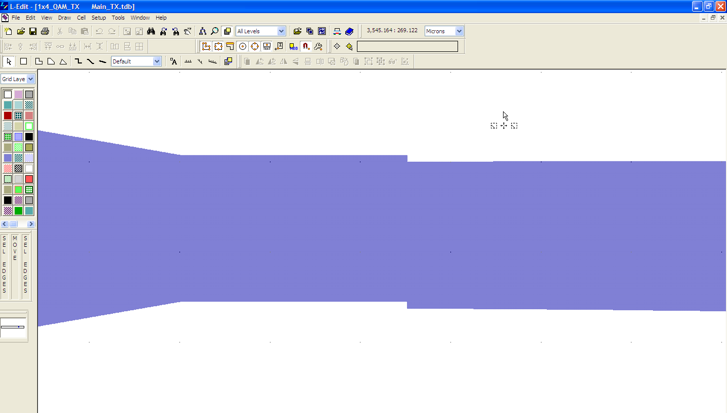
An offset example

Slide 21
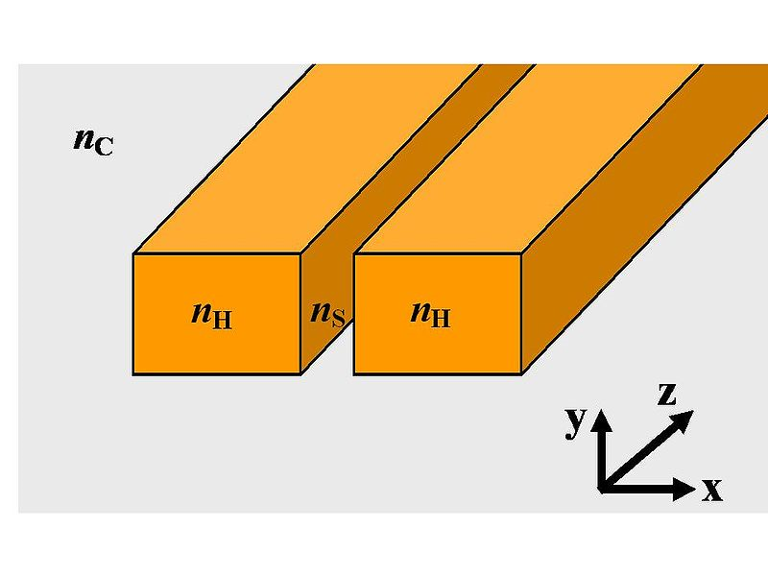
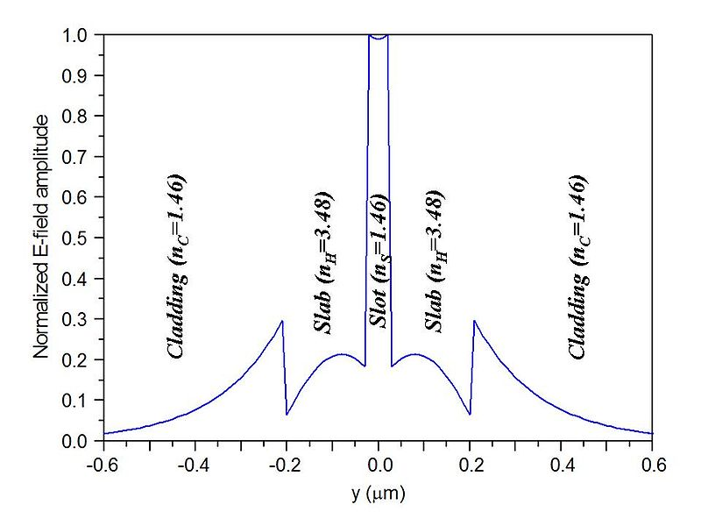
Slot Waveguides
High power density, low dispersion structures
Use Maxwell’s equations boundary conditions to our advantage
  D_{H} = D_{S} => ε_{H}E_{H} = ε_{S}E_{S} =>(n_{H})²E_{H} = (n_{S})²E_{S}

Slide 22
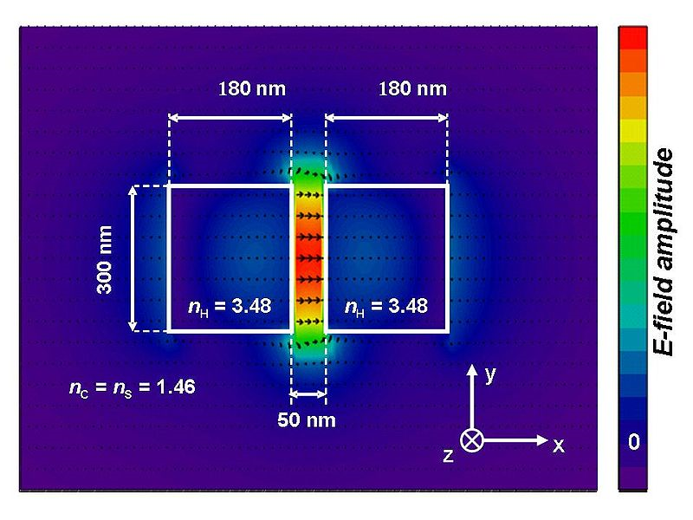
Slot Waveguides
  High index contrast means that E field in the ‘slot’ will be much higher
  Keep slot width less or equal than 1/γ

Slide 23
Total Internal Reflection Mirrors
How to make very compact devices

Slide 24
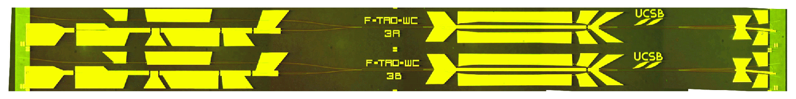
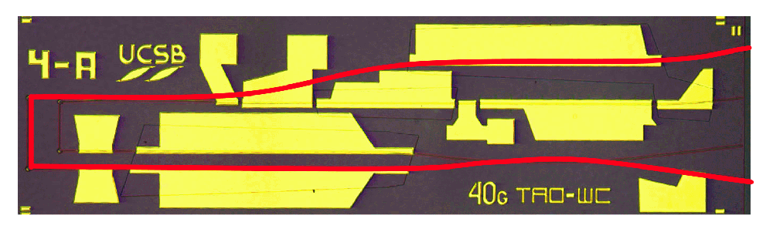
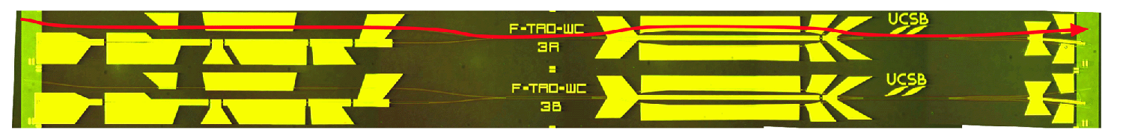
Integration Technologies
TIR Mirrors
• Goal: Compact Photonic Devices
-greater # of devices per chip
-better fabrication uniformity
-lower $ per device
PIC
PIC
PIC
PIC
PIC
PIC
PIC
PIC
• Limitation: Waveguide is low confinement
-sharp bends have high radiation loss
-designs are quasi-1 dimensional
-footprint determined primarily by length
InP
InGaAsP
InP
Input
Input
Output
Input
• Approach: TIR mirrors
-total internal reflection (TIR) mirrors
-discrete high index contrast interface
-small turning radius
InP
InGaAsP
Air
Output
InP
Notes:
The motivation behind most photonic circuits work is high performance and functionality. We want to be able to incorporate several functions onto the same substrate using the same processes (for example, lasers, modulators, etc..).
And that requires a common material and fabrication process. For our group, we’ve used the offset quantum well platform. We’ve used that platform to successfully integrate all of the above.
One of the limitations of this platform and many other active-passive platforms is that it’s low confinement. Here we have a fairly crude drawing of the optical mode, but what it’s representing is that the mode is not strongly confined to the core - the index contrast between the ridge core and the cladding is small, and this limits the bending radius of the waveguides. Consequently, designs are essentially 1-dimensional, with compact waveguide delays or folded devices impossible to achieve.
To get around this limitation, we use TIR mirrors. This consists of an etched trench that provides a discrete high-index contrast air-InP interface off of which the mode can reflect.

Slide 25
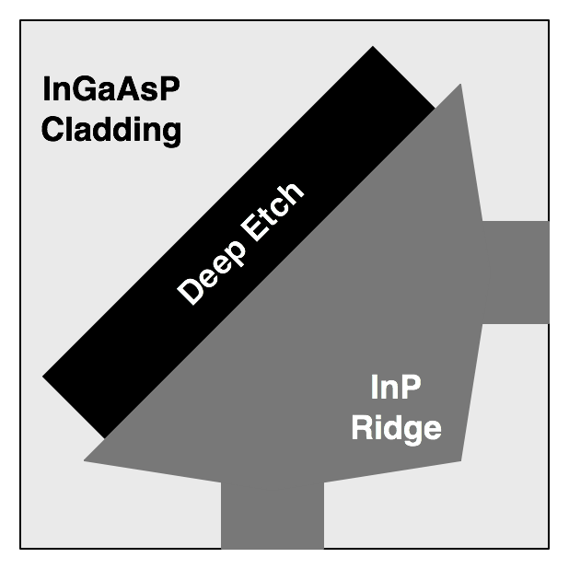
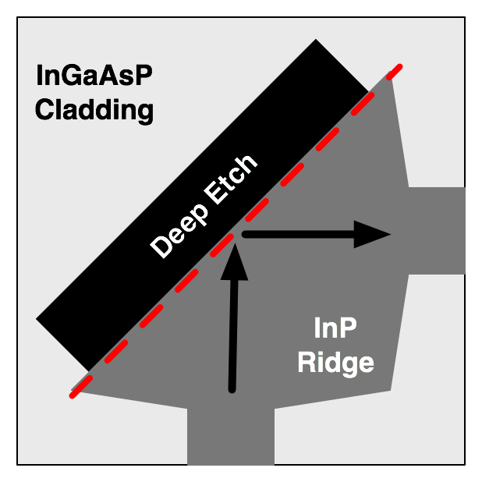
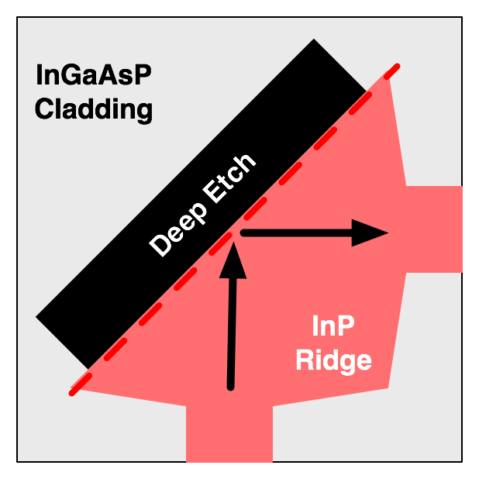
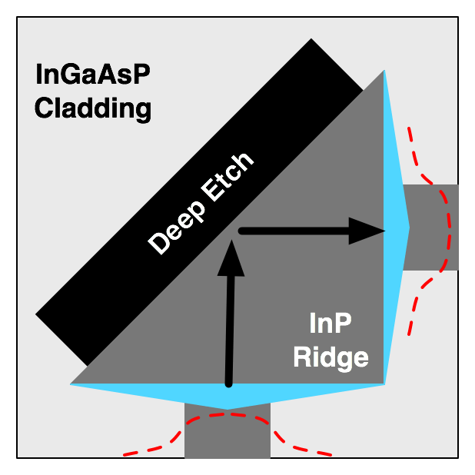
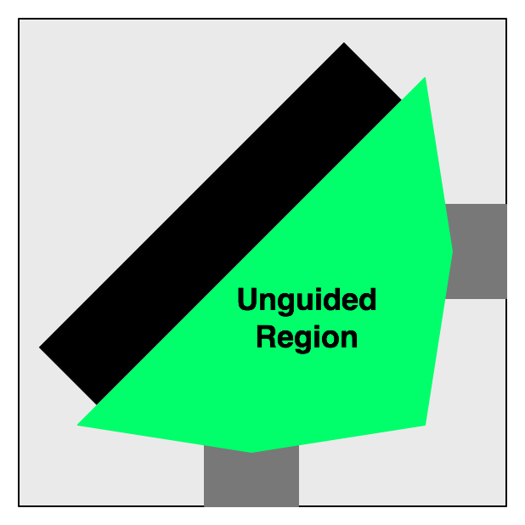
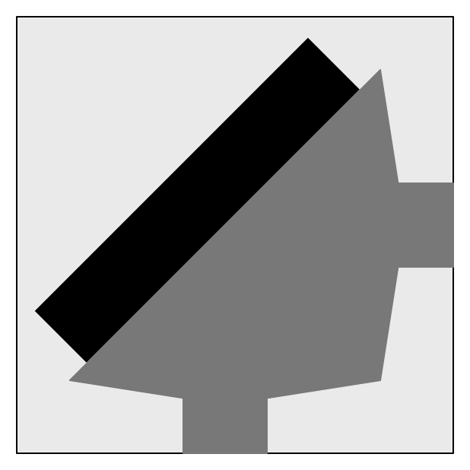
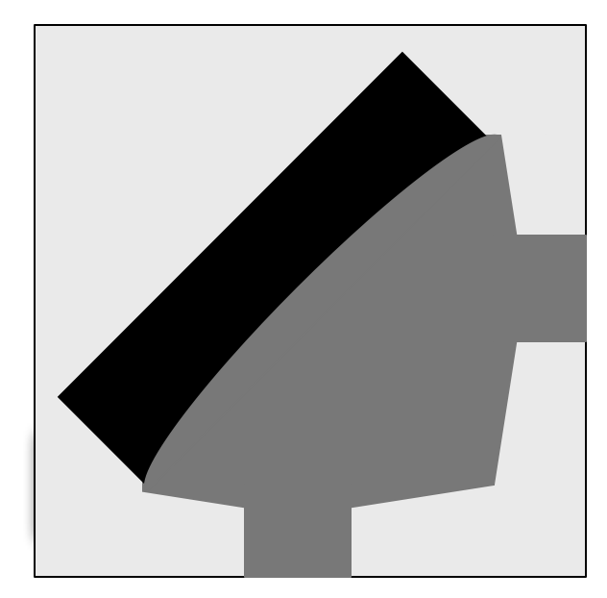
Integration Technologies
TIR Mirror Design
•Alignment between mirror and waveguide is achieved through a self-aligned process.
•The ridge mask layer defines both the waveguides and the mirror interface.
•The deep etch alignment doesn’t have to be perfect
Planar
Concave
•Waveguide tapers allow wide mirror to reflect entire mode (evanescent tails)
Solution: Concave mirrors to
compensate for diffraction
Design Trade-off
  • Self-aligned process requires unguided propagation
  • Greater alignment tolerance -> larger mirrors -> diffraction loss

Slide 26
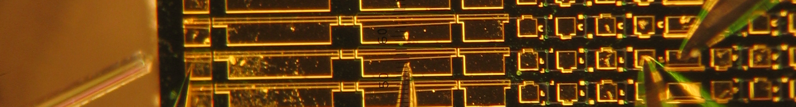
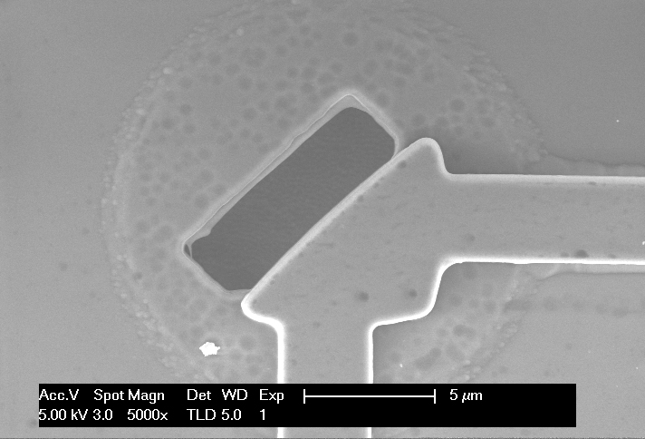
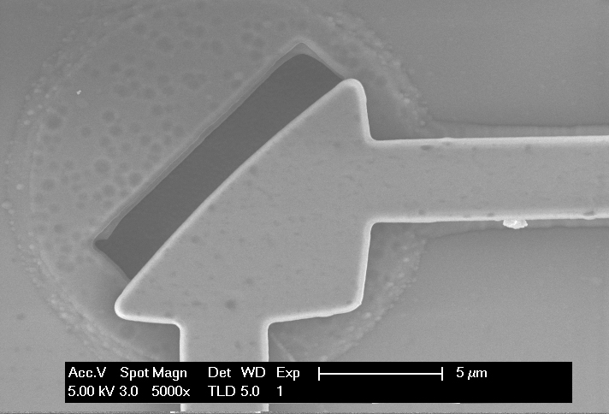
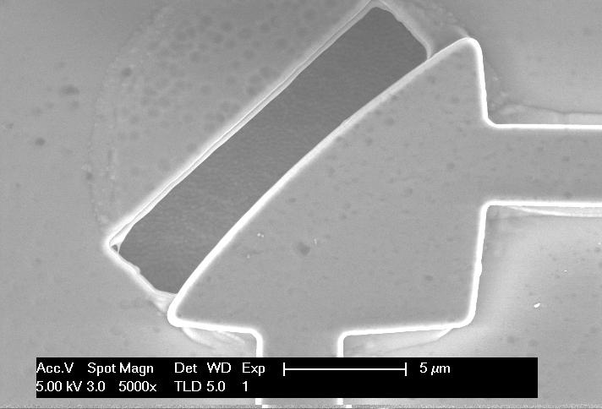
Integration Technologies
TIR Mirror Results
10um
• Tested 3 mirror sizes (10um, 14um, 18um)
• 18 mirror pairs of each size
• Sampled from different areas of 1/4 of a 2” wafer
 | Min (dB) | Max (dB) | Avg (dB) | St Dev (dB)
10um | 0.41 | 1.05 | 0.63 | 0.17
14um | 0.40 | 0.81 | 0.56 | 0.12
18um | 0.40 | 0.70 | 0.52 | 0.11
14um
18um
•Larger mirrors show improved loss and uniformity

Slide 27
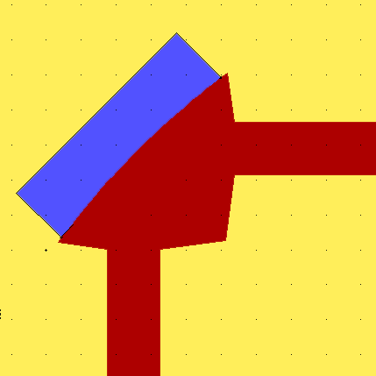
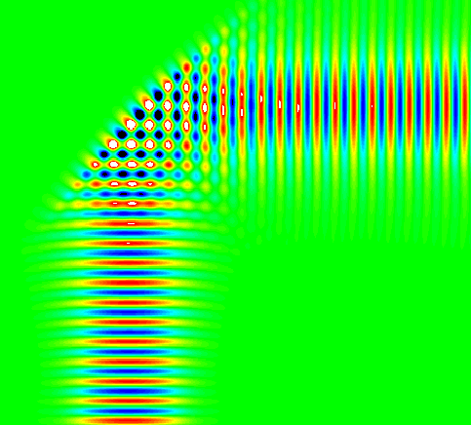
Integration Technologies
TIR Mirror Simulations
2D Finite Difference - Time Domain Model
• Effective indices for core and cladding
n=1
• Loss: overlap integral of input mode at output
• Mirror interface optimized to account for
Goos-Hanchen shift at mirror surface
n=3.263
n=3.204
• Different mirror sizes (widths) simulated
FDTD
Simulation
• Radius of mirror curvature adjusted to
optimize performance (R=50um)
Notes:
We simulated concave mirror designs using a 2D model and finite difference-time domain method.

Slide 28
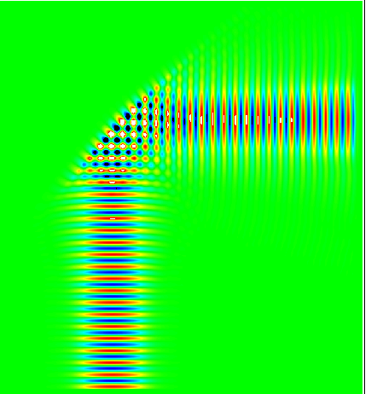
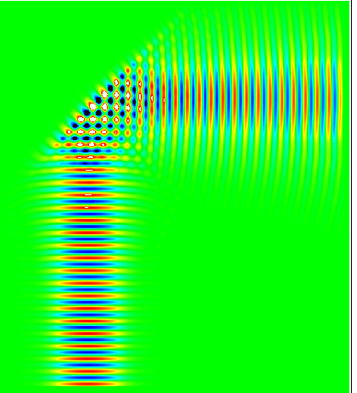
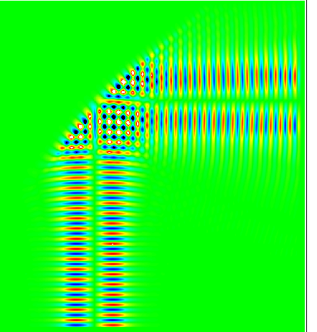
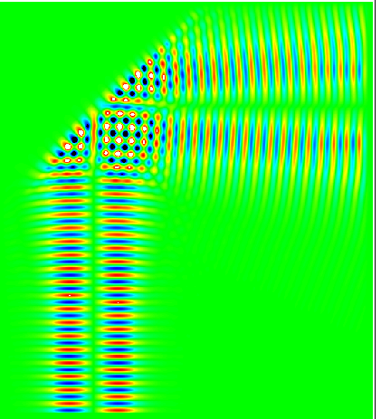
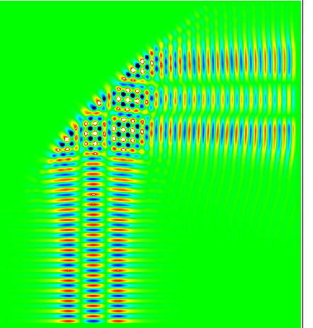

Integration Technologies
TIR Mirror Simulations
Concave Mirror
Planar Mirror
FD-TD Computed Loss
Fundamental
Fundamental
Mode
1st-Order
1st-Order
Mode
2nd-Order
2nd-Order
Mode
•Concave mirrors allow for large size without sacrificing loss
•Concave effectively reflects higher order modes (good or bad?)

Slide 29
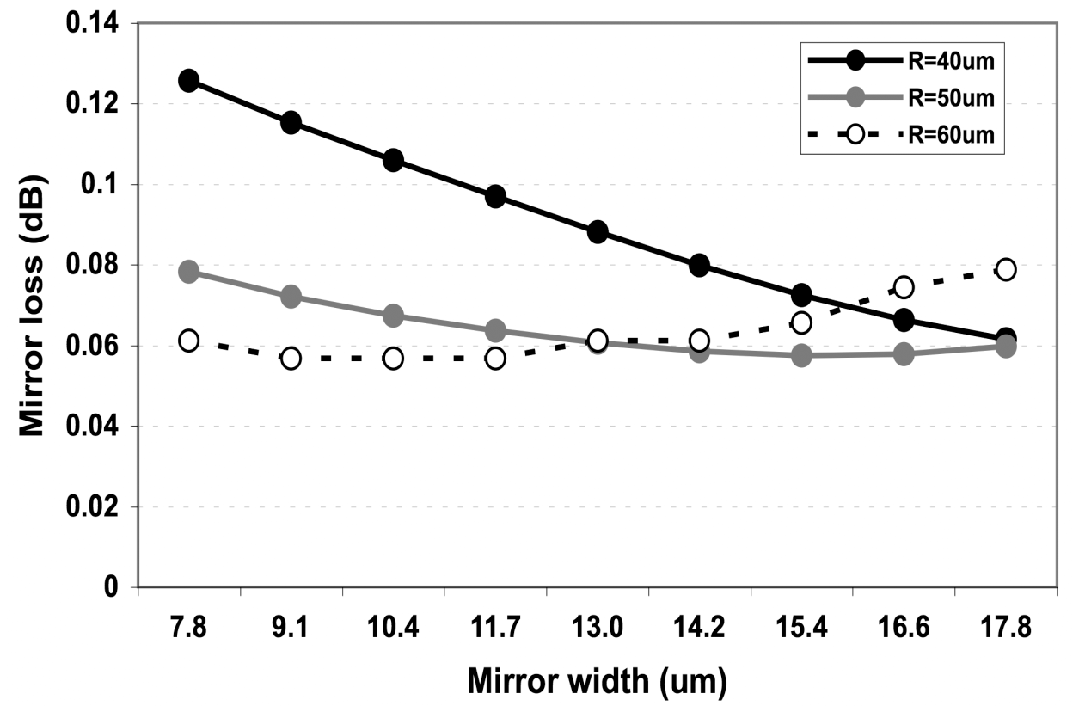
TIR Mirror Loss vs Design Parameters

Slide 30
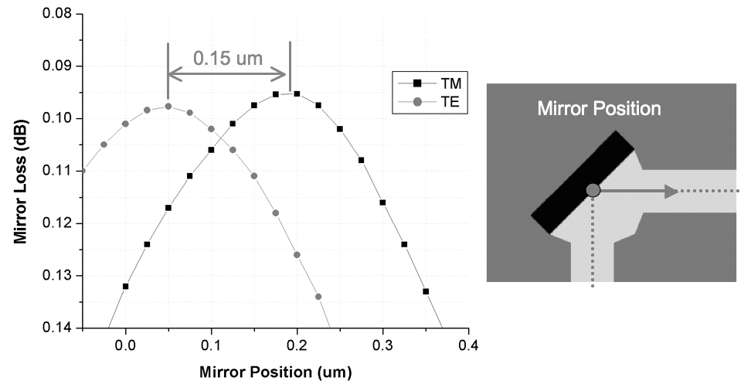
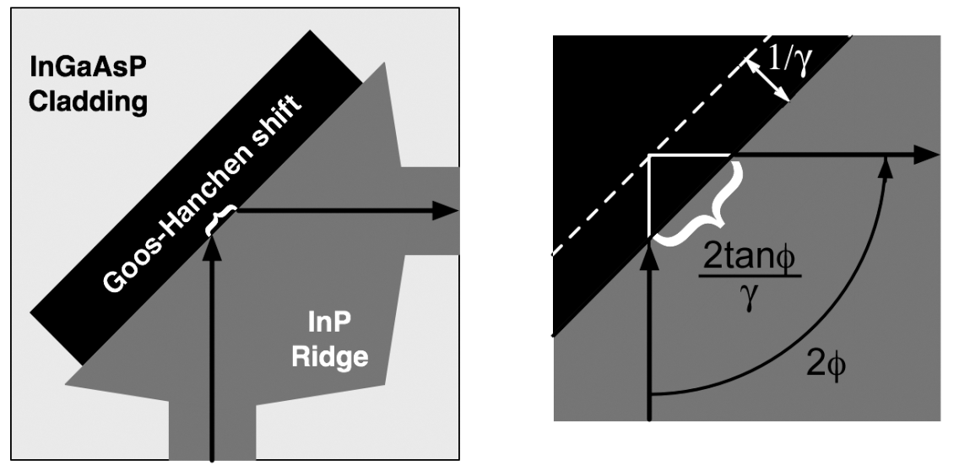
Goos-Hanchen Impact

Slide 31
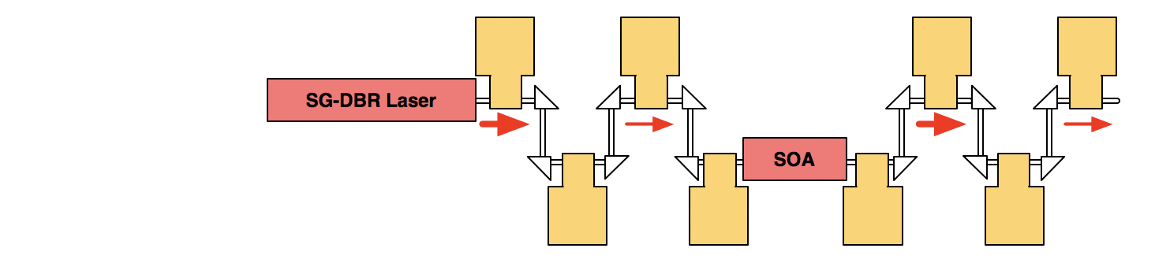
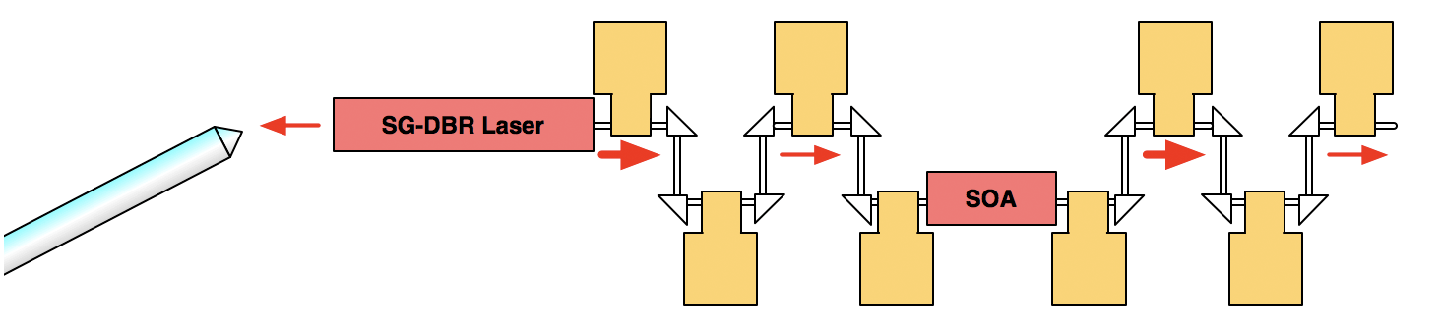
TIR Mirror Test Structures
• On-chip SG-DBR laser provides power
• Serpentine pattern of TIR mirrors
• Electrodes monitor power between mirror pairs
• SOA boosts power
• Fiber monitors spectrum from facet

Slide 32
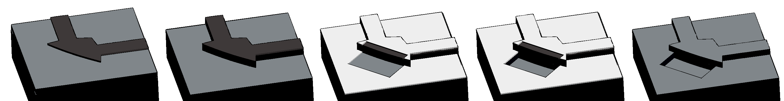
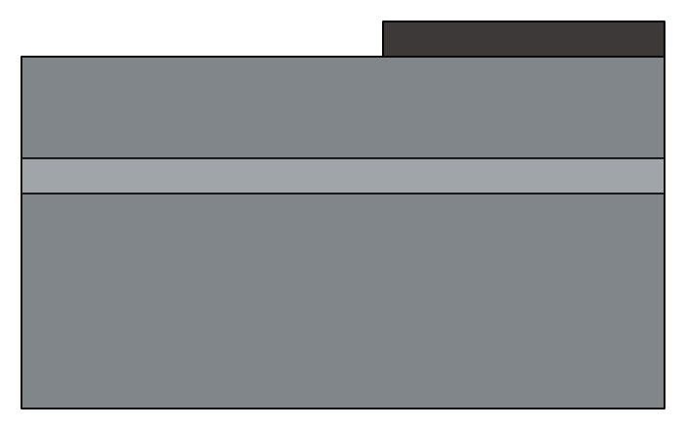
Integration Technologies
TIR Mirror Fabrication
1
SiNx
Define Ridge
- deposit SiNx hardmask
- etch SiNx hardmask
p-InP
InGaAsP
n-InP
Notes:
To understand the mirror design, it helps to first cover the self-aligned fabrication process.
First we define our waveguide ridge and mirror interface using a hard mask, which in this case is SiNx

Slide 33
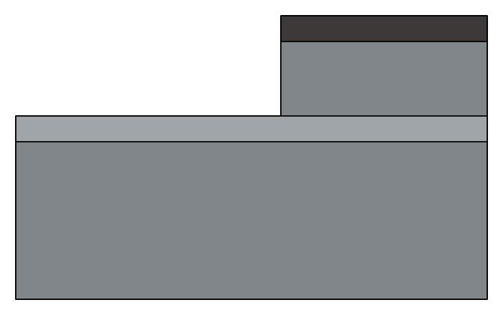
Integration Technologies
TIR Mirror Fabrication
2
SiNx
Etch Ridge
- RIE etch with MHA
- ~2um deep to InGaAsP layer
- Cycling with O2 etch to
remove polymer build-up
p-InP
InGaAsP
n-InP
Notes:
We next etch the ridge down to the waveguide layer. We use reactive ion etching, with methane/hydrogen/argon, cycled with short 02 plasma etches to help remove polymer buildup for more vertical sidewall.

Slide 34
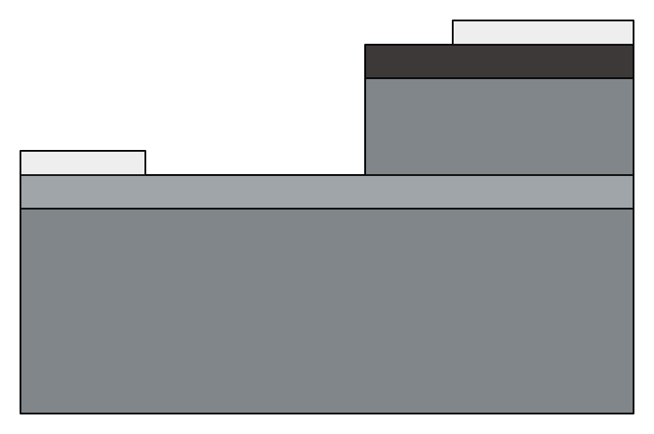
Integration Technologies
TIR Mirror Fabrication
3
SiO2
SiNx
Define Deep Etch Window
- Define window
- Evaporate SiO2
- Lift-off SiO2
p-InP
InGaAsP
n-InP
Notes:
We next pattern the deep etch window, evaporate SiO2, and lift off the SiO2 to expose an area adjacent to the ridge. Notice that the SiNx mask is responsible for defining the mirror surface adjacent to the ridge.

Slide 35
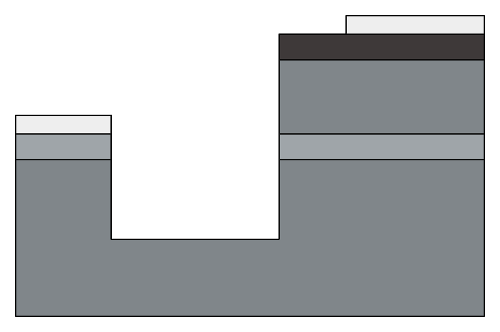
Integration Technologies
TIR Mirror Fabrication
4
SiO2
SiNx
Etch Mirror
- 2nd RIE etch with MHA
- ~1um below InGaAsP layer
- Cycling with O2 etch to
remove polymer build-up
p-InP
InGaAsP
n-InP
Notes:
A second etch is performed using the same RIE process as before - it’s important to etch deeply enough below the InGaAsP waveguide layer in order to reflect the entire optical mode.

Slide 36
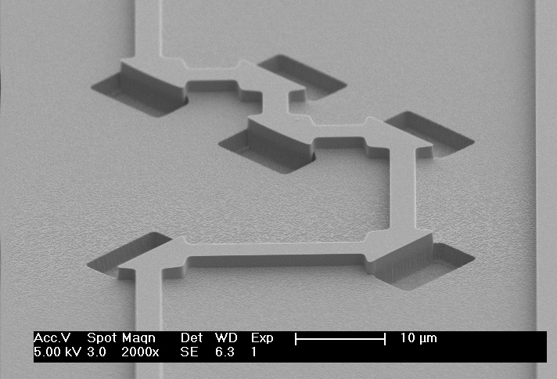
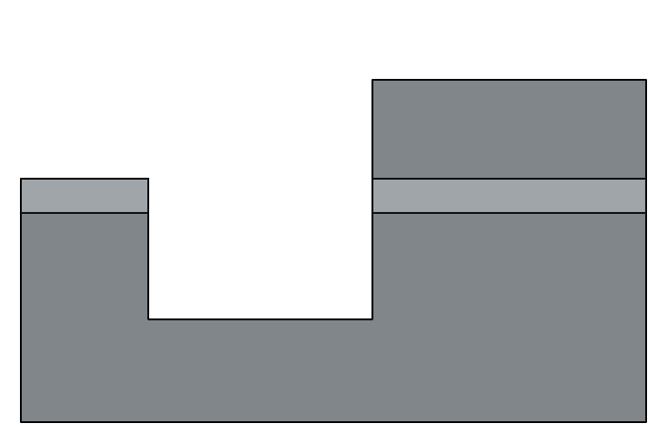
Integration Technologies
TIR Mirror Fabrication
5
Remove Hard Masks
- Dip in buffered HF
- Blanket passivate in SiNx
p-InP
InGaAsP
n-InP
Notes:
And finally we remove the etch masks, and passivate the entire structure.
And here’s an SEM of what these typically look like.

Slide 37

Arrayed Waveguide Grating Routers

Slide 38

Functions
Demultiplexer
Multiplexer
Router

Slide 39

Principles of Operation
Based on Rowland Circle construction
Star coupler – diffraction region
Phased array – introduces dispersion by linear increase of length of array waveguides
  Optical path length difference between adjacent waveguides equals an integer multiple of the central wavelength of the demultiplexer
For central wavelength, field distribution from the input is reproduced

Slide 40

Design Parameters
An AWGR device is fully specified by following characteristics :
number of channels N
central frequency f_{c} and channel spacing Δf_{ch}
L-dB channel bandwidth Δf_{L}
Free spectral range Δf_{FSR}
maximal insertion loss of the central channel
maximal nonuniformity L_{u}
maximal polarization dependence

Slide 41






Design process - Illustration

Slide 42

Different Geometries

